Slide 1

JAYARETHANAM PILLAI
TRISTAN FOO YINGKI LO
ASSESSMENT OF CHEERS SALES PERFORMANCE & CREATION OF A ‘GO-TO-MARKET’ STRATEGY

Slide 2

2:PREAMBLE – BUSINESS OBJECTIVES
CHEERS ESTABLISHED IN SINGAPORE IN 2001, AS A NUTRITIONAL SUPPLEMENT RETAILER
SINCE INCEPTION CHEERS HAS INTRODUCED LOYALTY PROGRAMMES
ATTRACTED MORE THAN 10,000 SIGN-UPS
CHEERS IS CONSIDERING CREATING AN ECOMMERCE WEBSITE FOR ONLINE SHOPPING
AIM IS TO CREATE A LOCAL COMPREHENSIVE ONLINE ONE-STOP SHOP FOR NUTRITION AND SUPPLEMENTS

Slide 3
3. SWOT Analysis
Strengths (Business Case) | Weakness (Problems identified)
Novel branding - fresh outlook to the consumers, signalling to them we can offer something new Healthy products evolving - sold by the idea of consuming health supplements for purposes such as weight loss, improved memory, or reducing carcinogens Proactive Consumer - consumers are increasingly willing to self-diagnose, self-medicate and self-monitor Brand-switching -increasingly normalized among Singaporean consumers; top reason, at 78%, why Singaporeans switch brands is due to them seeking products that provides good value for money, followed by price reductions and promotions at 73%. Sizeable proportion of all health supplement purchases - made from non-store retailing channels, such as eCommerce platforms - hovered around 20-30% from 2013 to 2018, with countries like Singapore & Malaysia even reaching about 50%. | Cheers is fairly new player - compared to other brands like GNC, Guardian etc. Singaporeans are spoiled for choice - generally categorized in the following manner - Herbal/Traditional Supplements (41%) & Standard Supplements (59%) Fail to understand the customer centric potentialities - growing e-commerce market Failure / or afraid - to explore marketing using strong 3rd party firms Failure to brand - accordingly to the niche customers markets Focus - more on the various customer markets to dedicate such supplements
Opportunities | Threats (Competitor Studies)
Booming health product market in SEA (valued at close to $10 billion) Rapidly growing SEA eCommerce industry (fueled by the demand of 120 million online shoppers throughout the region) Online Shopping Boom in SEA Popular eCommerce platforms - Tokopedia can receive up to 65 million monthly visits; Explore third party e-commerce to help in listing and tracking products More people in Singapore - popping health supplement pills as a quick fix when facing the pressures of a busy lifestyle Huge opportunity - Muslim consumers in the region | Market share- Other competitors have better resources :GNC - 9.5%; Suntory Holdings – 8.6%; Nu Skin – 5.8%; Amway Corp – 4.7%; Bayer AG - < 4% Lack of secure database management Slacking on customer security and satisfaction can drastically reduce trust Price competitiveness - ‘think global but go local’- glocal mindset is key to success Halal Law Requirements(Halal Certification) -is seen as barrier by many new market players, being able to reach out to the masses can help you to position yourself as a strong competitor in the market. [look at the big picture]

Slide 4
4:DATA DESCRIPTION, ASSUMPTIONS (IF ANY)
Dataset:
Data for offline transactions in 2001 collected by customer loyalty cards (customer ID, dates of visit and sales amount)
Hypotheses we had in our minds:
Q2 and Q4 will have the highest sales (holiday season) -> To explore seasonality
Frequent Customers tends to also spend more -> To do RFM analysis
Novel customers will be attracted to promotions, making big one-off transaction -> To do RFM analysis
Assumptions
Customers’ offline transaction habits = Online Transactions habits
There is a big group of curious market that have not bought from Cheers (potential customers)
Notes:
Based on the market research we done, we assume that :
Q2 ans Q4 will have higher sales as these are the hol

Slide 5
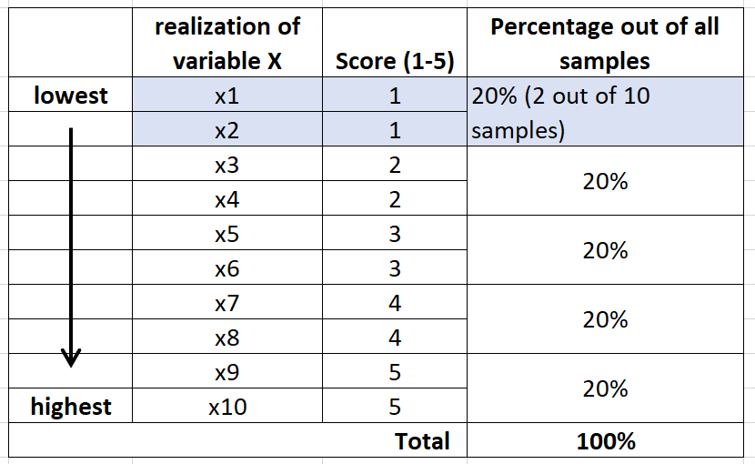
4:METHODOLOGY
Clean Dataset & EDA
Seasonality was investigated
Create Recency Frequency Monetary (RFM) table, based on transaction data from each customer
RFM Scoring (approach based on table on the right)
Customer Segmentation with Kmeans Clustering (using the RFM scoring done in Step 4)
Variables:
R-recency (How recently did the customer last make a purchase?)
F-frequency (How often did the customer make a purchase?)
M-monetary (How much did the customer spend with us?)
Notes:
RFM All variables are distributed with a scoring system of 1 to 5. Scaling is not required. (5–5–5 is the best customer, 1–1–1 is the least valuable.

Slide 6
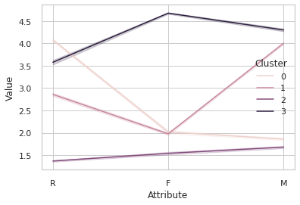
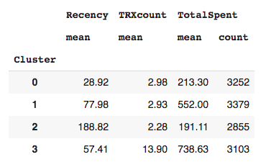
5:FINDINGS AND RESULTS
4 customer segments emerged:
Cluster | Segment name | Description | Remarks
0 | New customers | Recent shoppers with low frequency & spending | Encourage them to visit and buy more
1 | Potential Loyalists | Heavy spenders, but do not transact frequently. Transacted rather recently. | Could be responsive to promotion
2 | Churned customers | Low frequency and spending. Haven’t transacted for a long time | Efforts to re-engage
3 | Most valuable customers | Frequent & recent shoppers. Heavy spending | Retention will be key
Customer base seems healthy, with 2 heavy spending segments, that have transacted relatively recently.
There are also quite a big segment of ‘new customers’ where Cheers can further engage.

Slide 7




6: RECOMMENDATIONS / ACTION ITEMS
Most valuable customers
New customers
Churned customers
Potential Loyalist
Strategy: Reward & Engage | Strategy: Build Relationships | Strategy: Re-engage | Strategy: Engage & lead them to become loyal customers
Multiplier for loyalty points, which can be exchanged for products | Give out coupons/discount codes for new sign-ups | Offer discount codes and coupons after a certain period of inactivity | Monthly Sales Promotion
Exclusive promotions/deals (eg. Birthdays, Anniversary etc) | Referral codes to entice them to recruit more to come onboard the app | Simplify the UX in registration and website/app | Sports Celebrities endorsement to improve company branding
‘Early access’ to new products | Gamify reward schemes (Eg. Advent Calendar during Xmas) |  | Incentivise them to buy more frequently (e.g ‘VIP benefits’ listed for ‘most valuable customers’)
Personalised Account Manager | “Limited time period deal” |  | “Limited time period deal”
“Joie” (Chatbot) available 24/7 and Cashback Schemes Future CRM Initiatives

Slide 8
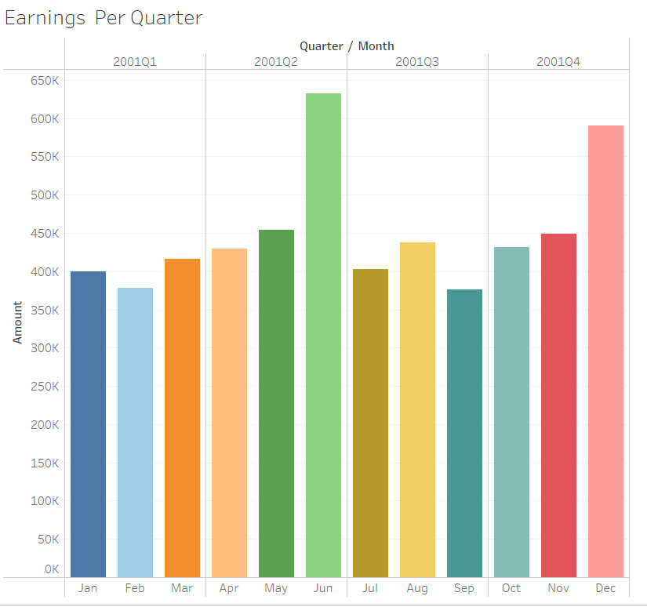
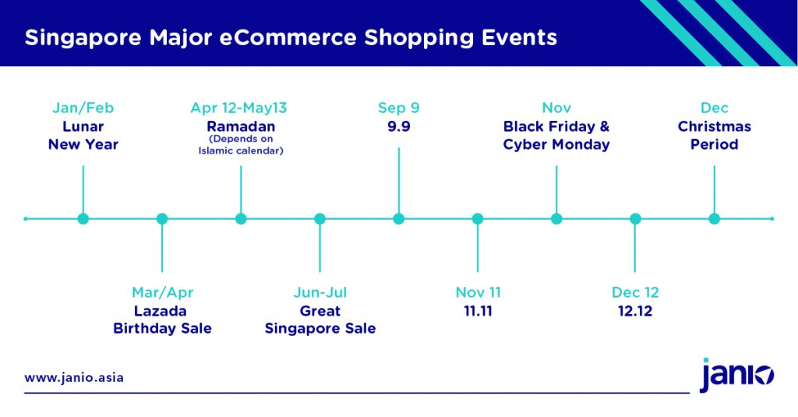
6: RECOMMENDATIONS / ACTION ITEMS
Best ‘time of the year’ to run campaigns
Analysis of the data showed the highest sale happened in June & Dec. In this day & age, however, we need to run multiple campaigns throughout the year to ride on the regular e-commerce campaigns various platforms are doing throughout the year.

Slide 9



7: FUTURE CRM INITIATIVES
Track what products customers are buying & habits (e.g. consistency)
Track customer sentiments of products
Customers’ persona
Potential use-cases
More precise persona & segmentation -> better customer understanding -> better cross/up-sell opportunities
Identify how much interaction each persona is comfortable with
Feed into product innovation

Slide 10
THANK YOU!

Slide 11
8:Appendix [All web-content accessed, [ April 10 - 14, 2021]
Ministry of Health: Updates on COVID-19 (Coronavirus Disease 2019) Local Situation
Money Smart: COVID-19 Is Disrupting The Economy In These 7 Industries
Euromonitor: Dietary Supplements in Singapore
Channel News Asia: Traditional Chinese Medicine to play important role as Singapore population ages
Euromonitor: Dietary Supplements in Singapore
Ibid
Nutra-Ingredients Asia: Coronavirus in Singapore – Vitamin demand jumps five-fold in two weeks for supermarket chain
Euromonitor: Vitamins in Singapore
Euromonitor: Herbal/Traditional Products in Singapore
Euromonitor: Dietary Supplements in Singapore
Nielsen: Global Brands Are Winning the Battle for Singaporean Consumers’ Hearts and Minds
Business Times: Brand disloyalty ‘the new normal’ for Singapore consumers: Nielsen survey
Money Smart: COVID-19 Is Disrupting The Economy In These 7 Industries
Today Online: More Singaporeans turning to online shopping for better bargains
McKinsey: Cashing In On The Booming Market for Dietary Supplements
Oliver Wyman: Unlocking The Asia Pacific Consumer Health Opportunity
Think With Google: E-conomy SEA 2018: Southeast Asia’s Internet Economy Hits An Inflection Point
Straits Times: More in Singapore popping vitamins, supplements
DataReportal: Digital 2019 Spotlight: Ecommerce In Southeast Asia
Geek Culture: Lazada Singapore’s 7th Birthday Sale: Surprise Box Unboxing + Giveaway!
Straits Times: Online platforms take up booths at Chinatown Chinese New Year festive street bazaar

Slide 12
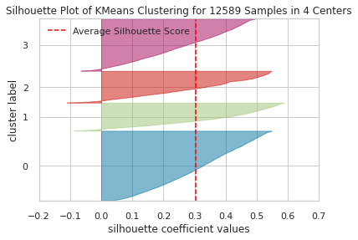
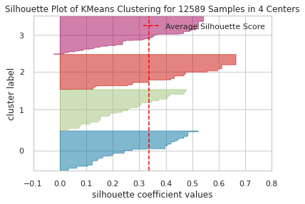
8:Appendix [Segmenting using KMeans VS. RFM Scoring + KMeans]
Silhouette Result for Segmentation just using KMeans (on actual data) Silhouette Result for Segmentation using RFM Scoring + KMeans
Silhouette score can be used to evaluate the quality of unsupervised learning models where the ground truth is unknown. Silhouette score measures how similar an observation is to its own cluster, as compared to other clusters.
Silhouette score for segmentation using RFM Scoring + KMeans is higher than using just KMeans on the actual RFM data.
Values closer to 1 indicate better cluster separation, while values near 0 indicate overlapping clusters. Avoid values that are negative.

